Slide 1
Notes:
1

Slide 2
2021 Cutting Edge Ingredients
Silk Proteins: Promotes cell repair and regeneration, boosts collagen production while helping to maintain the skin’s hydration, and gentle on the skin by protecting it against sun damage
Coffeeberry: Rich antioxidant that helps to neutralize free radical damage and help to prevent cellular damage in the skin, restores moisture and elasticity in the skin making it more soft and supple, works to minimize discolorations on the skin and softening fine lines and wrinkles, and protecting against photodamage from the sun
Cactus Water: High in antioxidants, vitamins and electrolytes, Cactus Water is good for all skin types where it works with antibacterial and calming properties to protect the skin from sun damage, aging and collagen loss
Notes:
2

Slide 3
2021 Cutting Edge Ingredients
Sugarcane Derived Squalane: Derived 100% from sugarcane, works to reduce the appearance of fine lines and wrinkles, helps to provide weightless hydration, balance excess oil, soothe, and promote a plump, firm appearance; non-comedogenic and suitable for all skin types and works to increase cell turnover in the skin by slowing water loss to retain moisture
Tumeric Root Extract: An antioxidant known for its’ anti-inflammatory properties; protects the skin from free radical damage, stimulates collagen production, works to reduce hyperpigmentation and scarring while helping to bring out the skin’s natural glow
Plum Oil: Quick absorbing oil with anti-aging properties that balances, refreshes and restores the skin. This non-comedogenic oil calms irritated skin while helping to naturally protect the skin barrier from the sun; ideal for all skin types – especially acne prone & extremely sensitive.
Notes:
3

Slide 4
2021 Cutting Edge Ingredients
Vegan Collagen: Helps to strengthen and condition the skin to visibly improve texture and suppleness while also helping to restore skin’s natural bounce and resilience, diminishing the look of fine lines and wrinkles
Revolutionary 4K Blend: Allows for deeper hydration and longer lasting tanning results as well as better penetration for the high end skincare ingredients, while also working to blur imperfections for a crystal clear complexion
Super Charged Electrolyte Cocktail: Utilizes Magnesium, Coconut Water, Sodium PCA, Orange, Almond, and Banana extracts to improve skins moisture barrier and strength, calm redness, protect against environmental dehydration, and work as a vital component in maintaining hydration levels in the skin
Notes:
4

Slide 5
Notes:
5

Slide 6
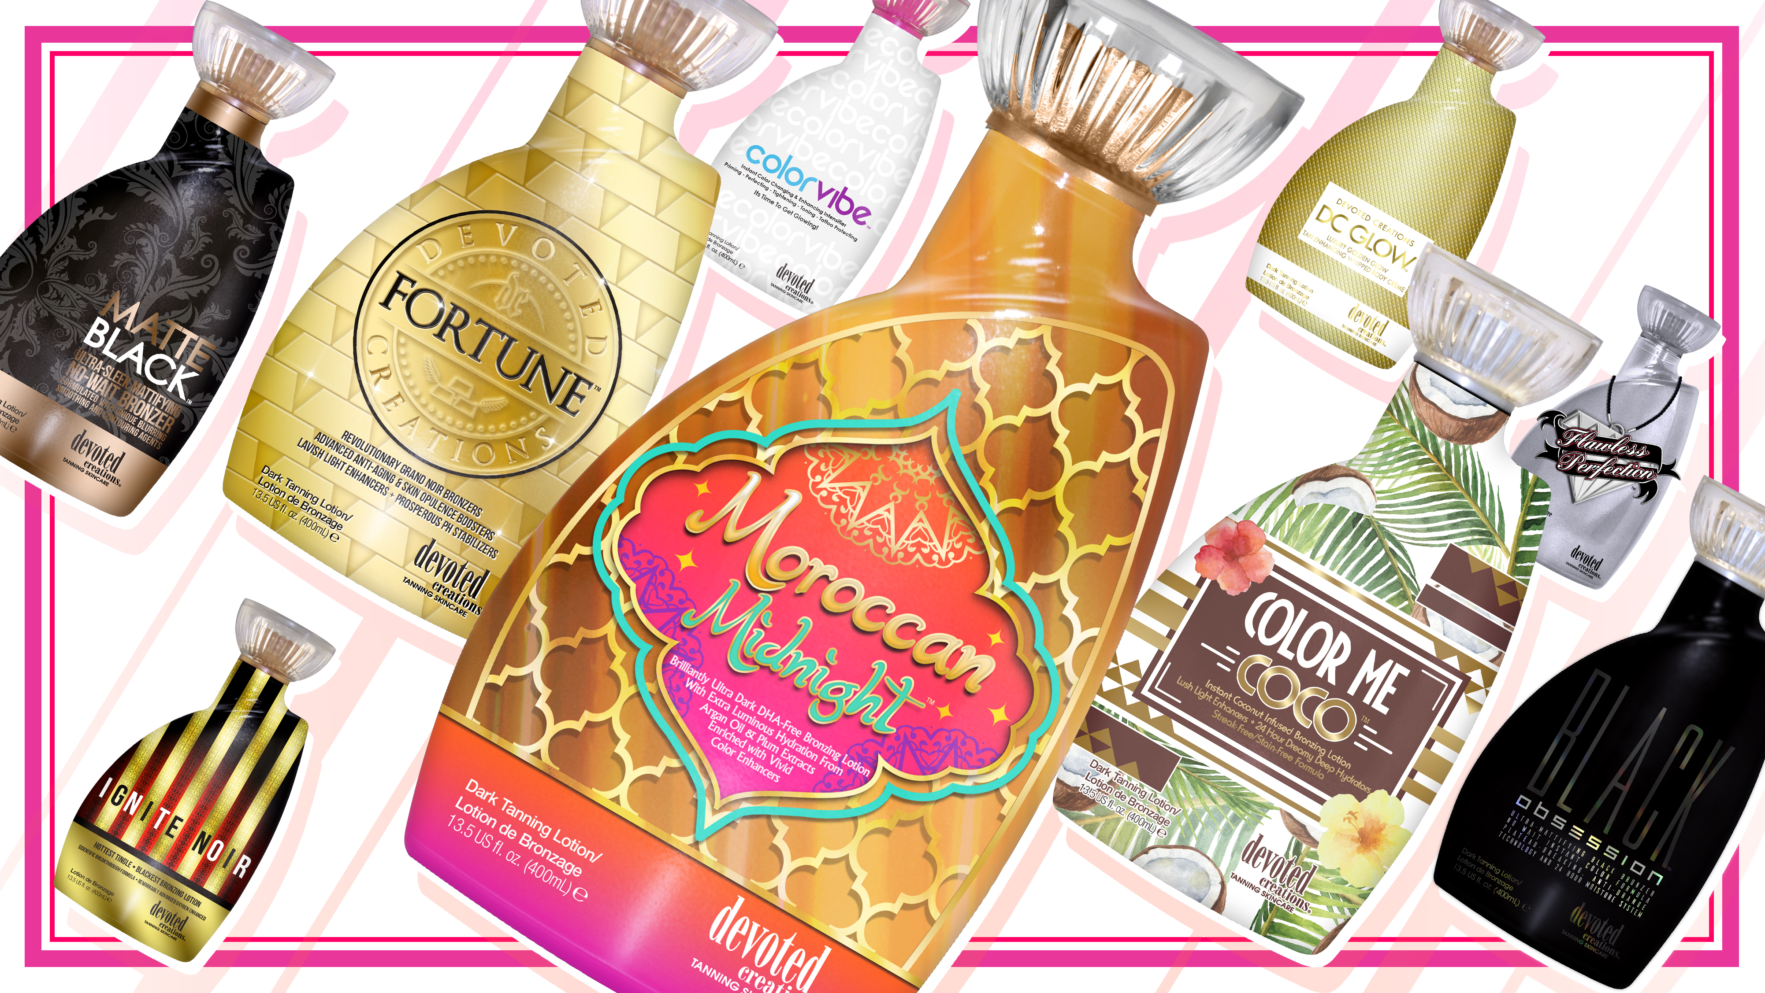
Notes:
6

Slide 8
Moroccan Midnight™ Brilliantly Ultra Dark DHA-Free Bronzing Lotion With Extra Luminous hydration from Argon Oil & Plum Extracts Enriched with vivid color enhancers
Formulated with multiple accelerators that work to target melanin production to deliver fast, dark tanning results
Super High levels of Natural and Cosmetic bronzers deliver a streak-free/stain-free bronzed result
Rich Caramel Extracts – Impart dark long-lasting color with self tanners
Added Argon Oil delivers a velvety smooth feeling to the skin while locking in moisture for the entire day
Plum Oil - a rich oil that offers a non-greasy and silky skin feel that moisturizes skin
PhytoCellTec binds to healthy skin cells, allowing healthy skin cells to live longer
Liquid Glass works as a primer to mask tiny imperfections in the skin
Tan extending and tattoo protecting blend
Kakadu Plum and Almond Oils are rich in antioxidants to help block free radical damage
Renovage anti-aging complex that reduces the appearance of fine lines and wrinkles
Fragrance: Midnight Moroccan Orchid
Notes:
8

Slide 9
Notes:
9

Slide 10
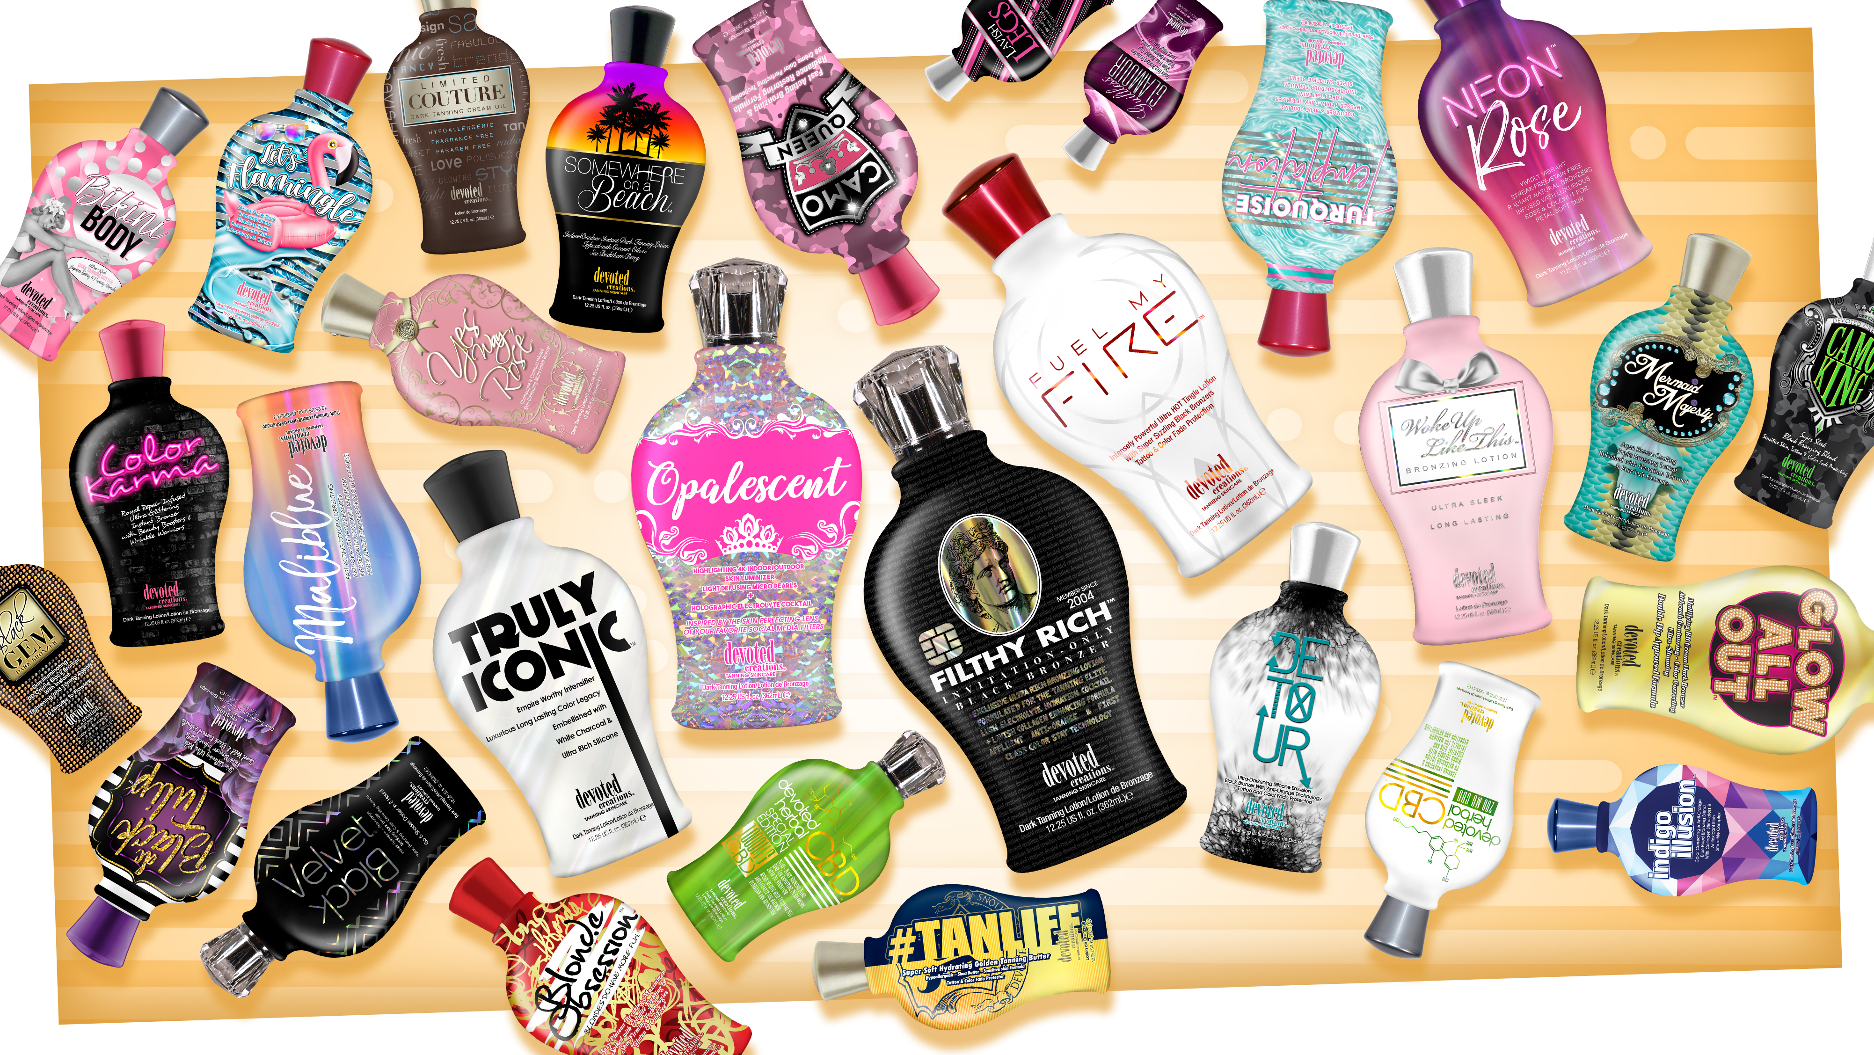
Notes:
10

Slide 11
Opalescent™ Highlighting 4K Indoor/Outdoor Skin Luminizer
Light Defusing Micro Pearls + Holographic Electrolyte Cocktail
Revolutionary 4K Blend – Allows for deeper hydration and longer lasting tanning results as well as better penetration of the high end skincare ingredients, while also working to blur imperfections and allow for a crystal clear complexion
Holographic Luminizer – Utilizes Crushed Diamond powder and Dimension creating Micro-Pearls. This ‘Flawless Filter” Creator refracts light and allows for transparent coverage to soften, focus, and illuminate the skin. It minimizes the appearance of fine lines and pores for a more refined, smooth appearance to the skin
Electrolyte Cocktail – Utilizes Coconut Water, Sodium PCA, Orange, Almond and Banana extracts to improve skin moisture barrier and strength, calm redness, protect against environmental dehydration, and work as a vital component in maintaining hydration levels in the skin
Green Clay – Works overtime to restore balance by absorbing excess oils that clog pores and lead to acne and imperfections. This revolutionary clay also balances pH levels, making it optimal for use in multi0ple types of salon equipment
Willow Bark & Witch Hazel – Target and shrink the appearance of large pores and sagging skin for a tightened and more youthful appearance
Bakuchiol – Works by increasing cell turnover, thereby stimulating collagen production and diminishing wrinkles, skin laxity, and overall photo damage
Body Fit™ Technology – Reduces the appearance of cellulite and restores firmness.
FreshTek™– A proprietary blend of deodorizing and skin freshening ingredients.
Advanced Matrixyl Synthe 6™ – Powerful anti-aging peptide that reduces the appearance of fine lines and wrinkles for long-lasting results
Fragrance: Opal Essence
Notes:
11

Slide 13
Filthy Rich™ Exclusive Ultra Rich Bronzing Lotion Formulated for the tanning Elite
Lush Electrolyte Hydration Cocktail + Lavish Collagen Enhancing Formula
Affluent Anti-Orange & First Class Color Stay Technology
Invitation Only Black Bronzer
Revolutionary 4K Blend – Allows for deeper hydration and longer lasting tanning results as well as better penetration of the high end skincare ingredients, while also working to blur imperfections and allow for a crystal clear complexion
Rich Black Bronzing Formula – Utilizing DHA, Natural & Cosmetic Bronzers this formula will give you extremely dark immediate color as well as super dark long lasting color
Supercharged Electrolyte Cocktail – Utilizes Magnesium, Coconut Water, Sodium PCA, Orange, Almond and Banana extracts to improve skins moisture barrier and strength, calm redness, protect against environmental dehydration, and work as a vital component in maintaining hydration levels in the skin
Sugarcane Derived Squalane™ – Helps to provide weightless hydration, balance excess oil, soothe and promote a plump, firm appearance
Vegan Collagen – helps to strengthen and condition the skin to visibly improve texture and suppleness while also helping to restore skin’s natural bounce and resilience, diminishing the look of fine lines and wrinkles
Blue Tansy™ – Provides anti-orange agents so the skin develops the most natural, dark bronzed result
Charcoal Extracts – Helps to detoxify and pull impurities from the skin
Bakuchiol – Works by increasing cell turnover, thereby stimulating collagen production and diminishing wrinkles, skin laxity, and overall photo damage
Body Fit™ Technology – Reduces the appearance of cellulite and restores firmness
FreshTek™– A proprietary blend of deodorizing and skin freshening ingredients
Advanced Matrixyl Synthe 6™ – Powerful anti-aging peptide that reduces the appearance of fine lines and wrinkles for long-lasting results
Fragrance: Rich Mandarin Woods
Notes:
13

Slide 14
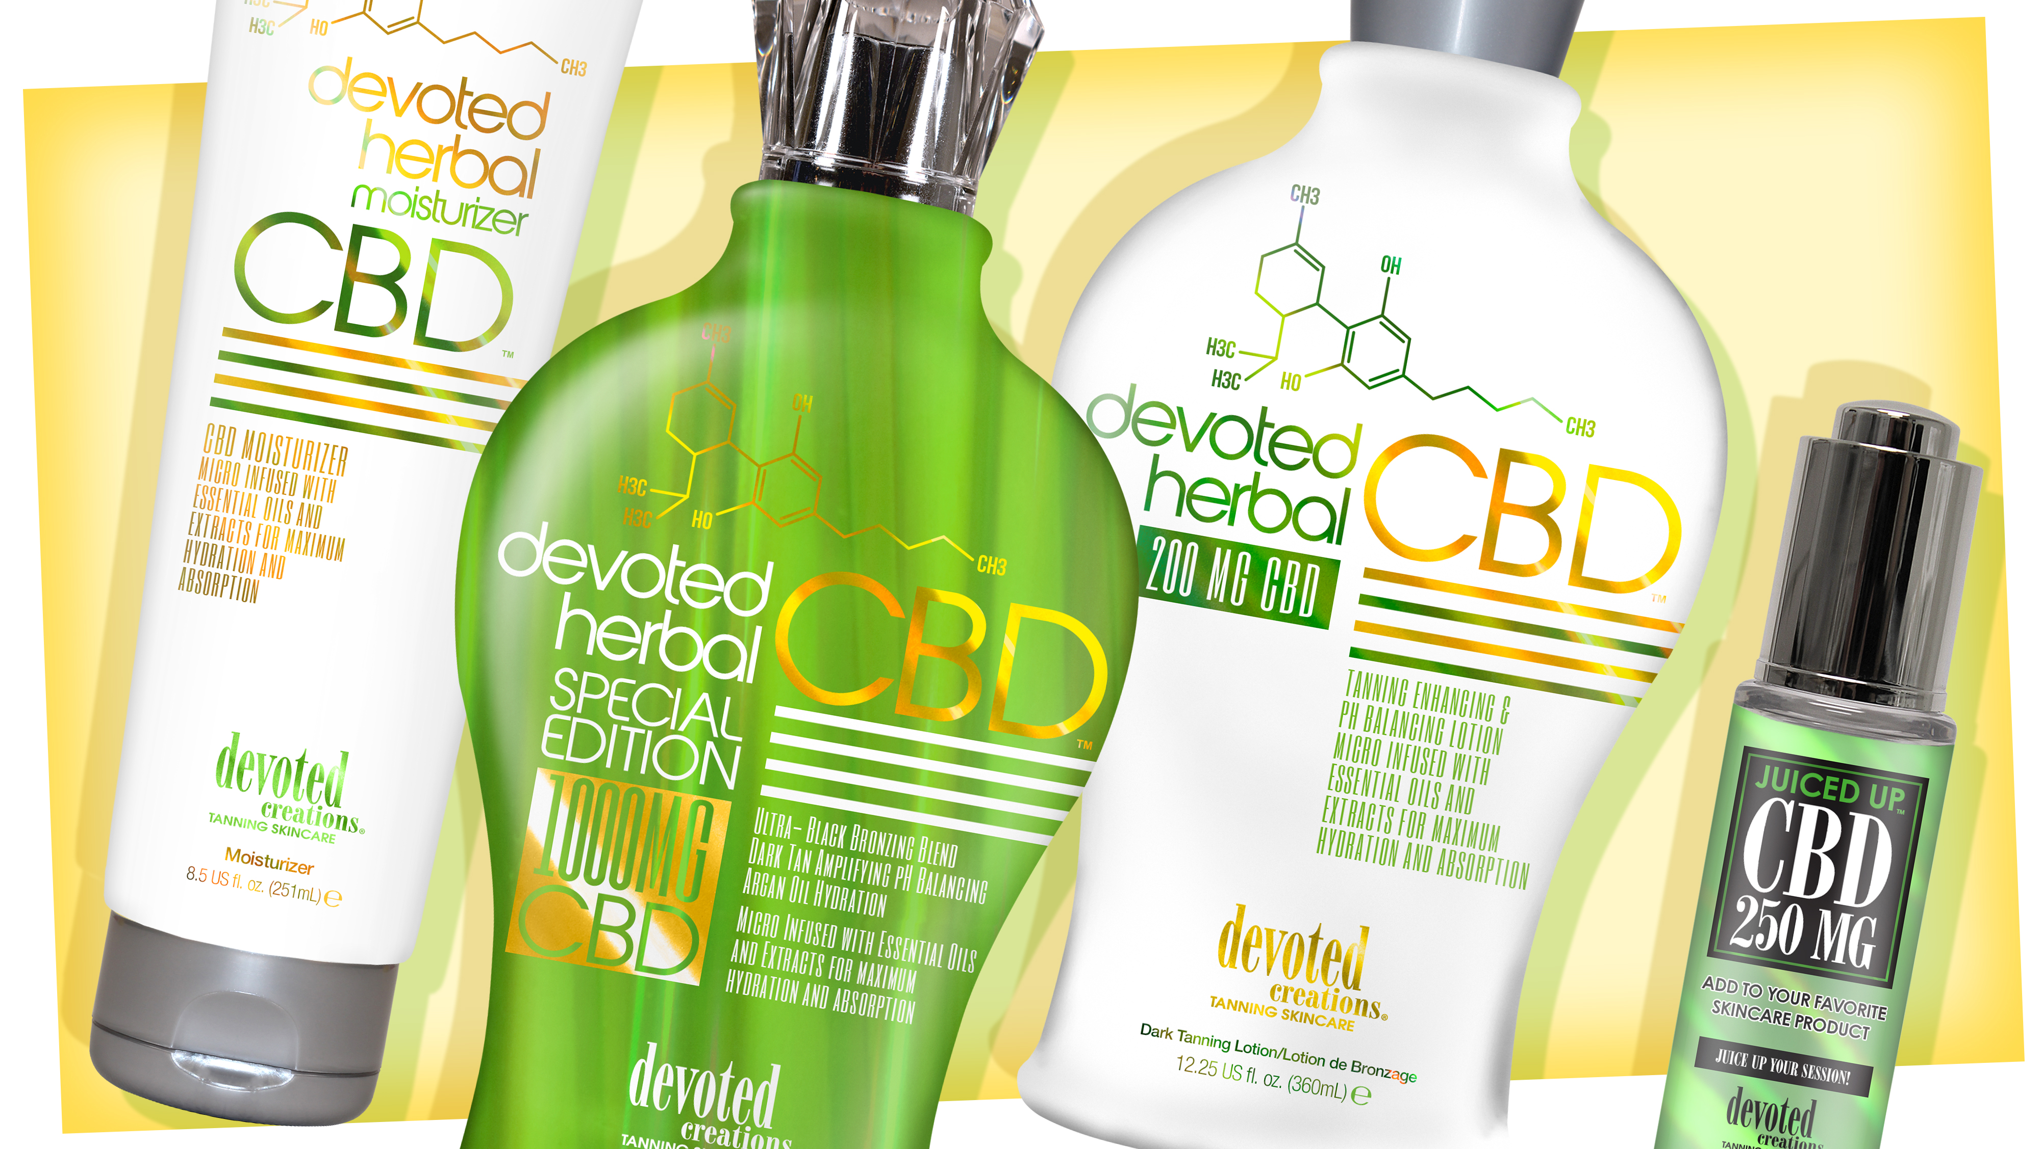
Notes:
14

Slide 15
DC Herbal™ 200 MG CBD
Tanning Enhancing & pH Balancing Lotion Micro Infused with Essential Oils and Extracts for maximum hydration and absorption
Plateau breaking dark tanning intensifier that allows for natural dark tanning results
CBD – Contains 200mg of Cannabidiol
pH Balancing Blend makes this ideal for use not only in UV light – but also red-light and as a cocktail tanning product
Hyaluronic Acid – Helps to boost collagen and elastin in the skin
Tea Tree Oil – Absorbs excess oil, detoxifies, and reduces inflammation while aiding in improving acne prone skin
Coconut & Hemp Seed Oil for natural skin softening
Advanced Matrixyl Synthe 6 – Powerful anti-aging peptide that reduces the appearance of fine lines and wrinkles for long lasting results
Blended with multiple accelerators that work to target color production and achieve fast, dark tanning results
Fragrance: Herbal Fields
Notes:
15

Slide 16
DC Herbal Special Edition™ 1000 MG CBD Formula
Ultra Black Bronzing Blend – Dark Tan Amplifying pH Balancing – Argon Oil Hydration Micro Infused with Essential Oils and Extracts for maximum hydration and absorption
Superior Dark bronzing complex allows skin to develop an immediate dark and delayed bronzing result
1,000 MG CBD Isolate Formula – Contains Natural Cannabidiol
pH Balancing Blend makes this formula optimal for use before or after all tanning and spa services
Photosomes – Used with any light therapy and helps protect the skins immune system
Hyaluronic Acid – Helps to boost collagen and elastin in the skin
Argon Oil – Deeply softening and nourishing
Ginger Root, Grapefruit Seed & Spearmint Oil – To reduce inflammation and irritation in the skin
Tea Tree Oil – Absorbs excess oil, detoxifies, and reduces inflammation while aiding in improving acne prone skin
Coconut & Hemp Seed Oil for natural skin softening
Coconut & Hemp Seed Oil for natural skin softening
Advanced Matrixyl Synthe 6 – Powerful anti-aging peptide that reduces the appearance of fine lines and wrinkles for long lasting results
Fragrance: Herbal Fields
Notes:
16

Slide 17
DC Herbal Moisturizer™ CBD Moisturizer
Micro Infused with Essential Oils and Extracts for maximum hydration and absorption
Superior hydrating formula
CBD – Contains Natural Cannabidiol
pH Balancing Blend make this formula optimal for use before or after all tanning and spa services
Hyaluronic Acid – Helps to boost collagen and elastin in the skin
Tea Tree Oil – Absorbs excess oil, detoxifies, and reduces inflammation while aiding in improving acne prone skin
Coconut & Hemp Seed Oil for natural skin softening
Advanced Matrixyl Synthe 6 – Powerful anti-aging peptide that reduces the appearance of fine lines and wrinkles for long lasting results
Fragrance: Herbal Fields
Notes:
17

Slide 18
Juiced Up Drops™ 250 MG CBD
”Juice Up Your Session”
CBD may help alleviate dry skin and dullness as well as help improve skin texture and reduce excess oil
Coconut Juice base works as a skin balancing agent to moisturize dry spots of the skin
Enhance your session by adding desired amount of drops to your Devoted Creations’ products for longer lasting color
Hemp Seed for extra hydration and skin conditioning benefits
Advanced Matrixyl Synthe 6 – Powerful anti-aging peptide that reduces the appearance of fine lines and wrinkles for long lasting results
Formulated Fragrance Free and sensitive skin approved making it suitable for all skin types
Fragrance Free
Notes:
18

Slide 19
Notes:
19

Slide 20
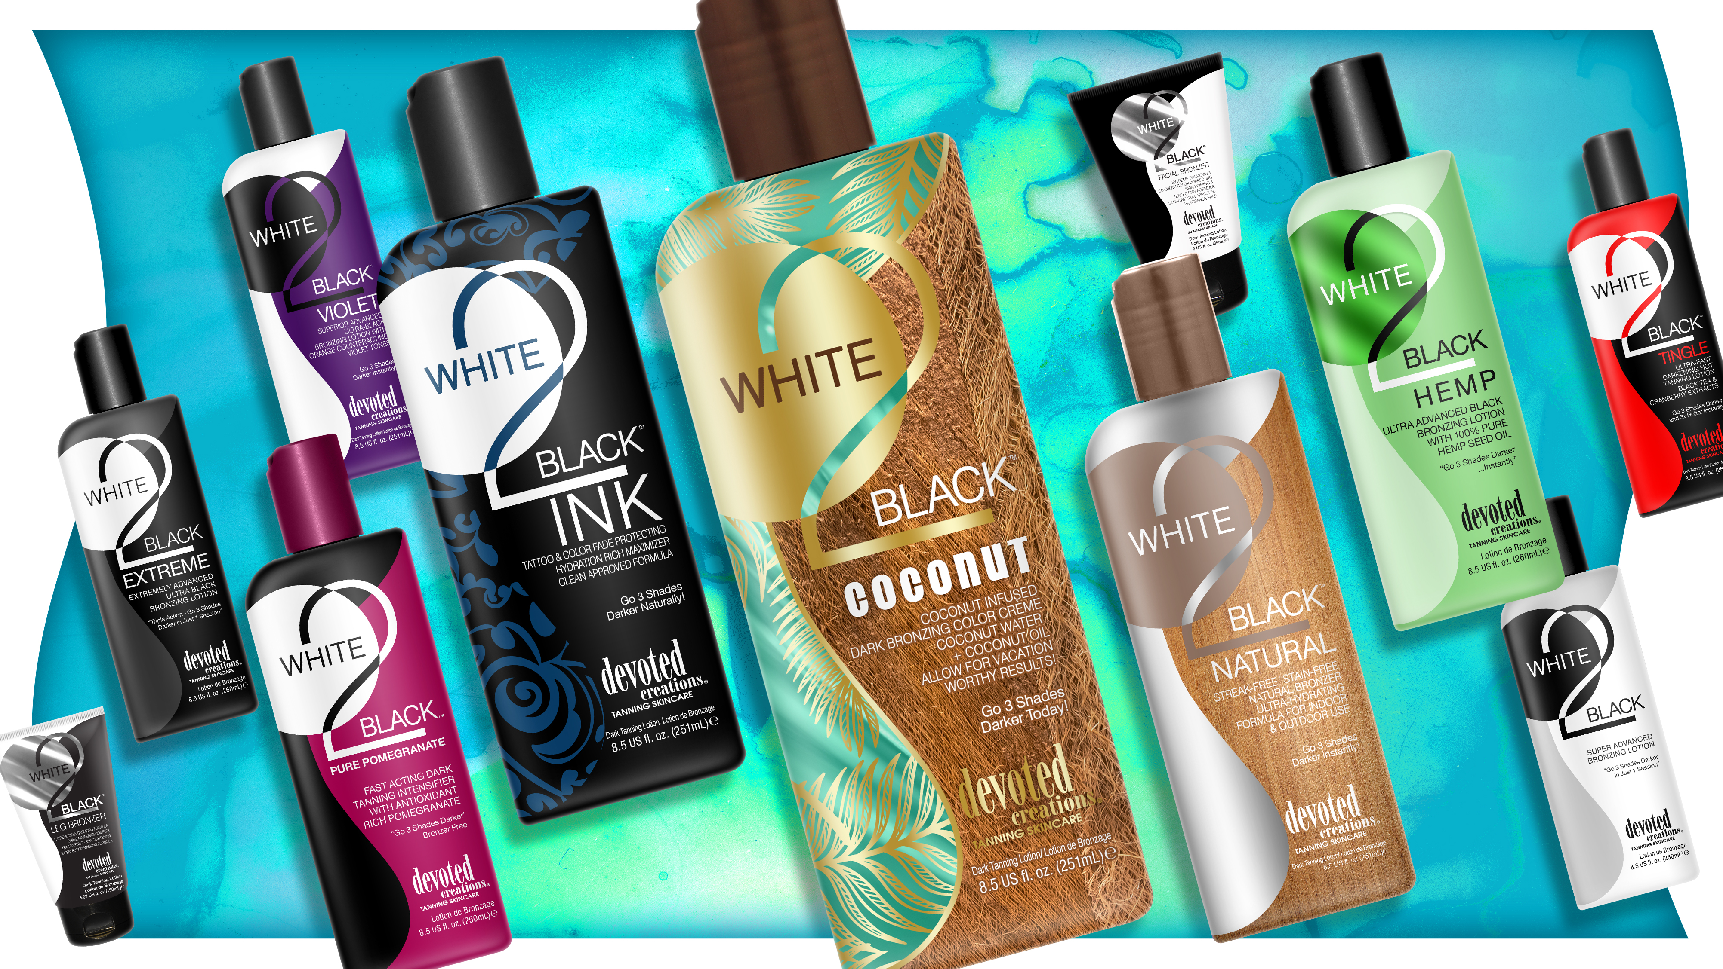
Notes:
20

Slide 21
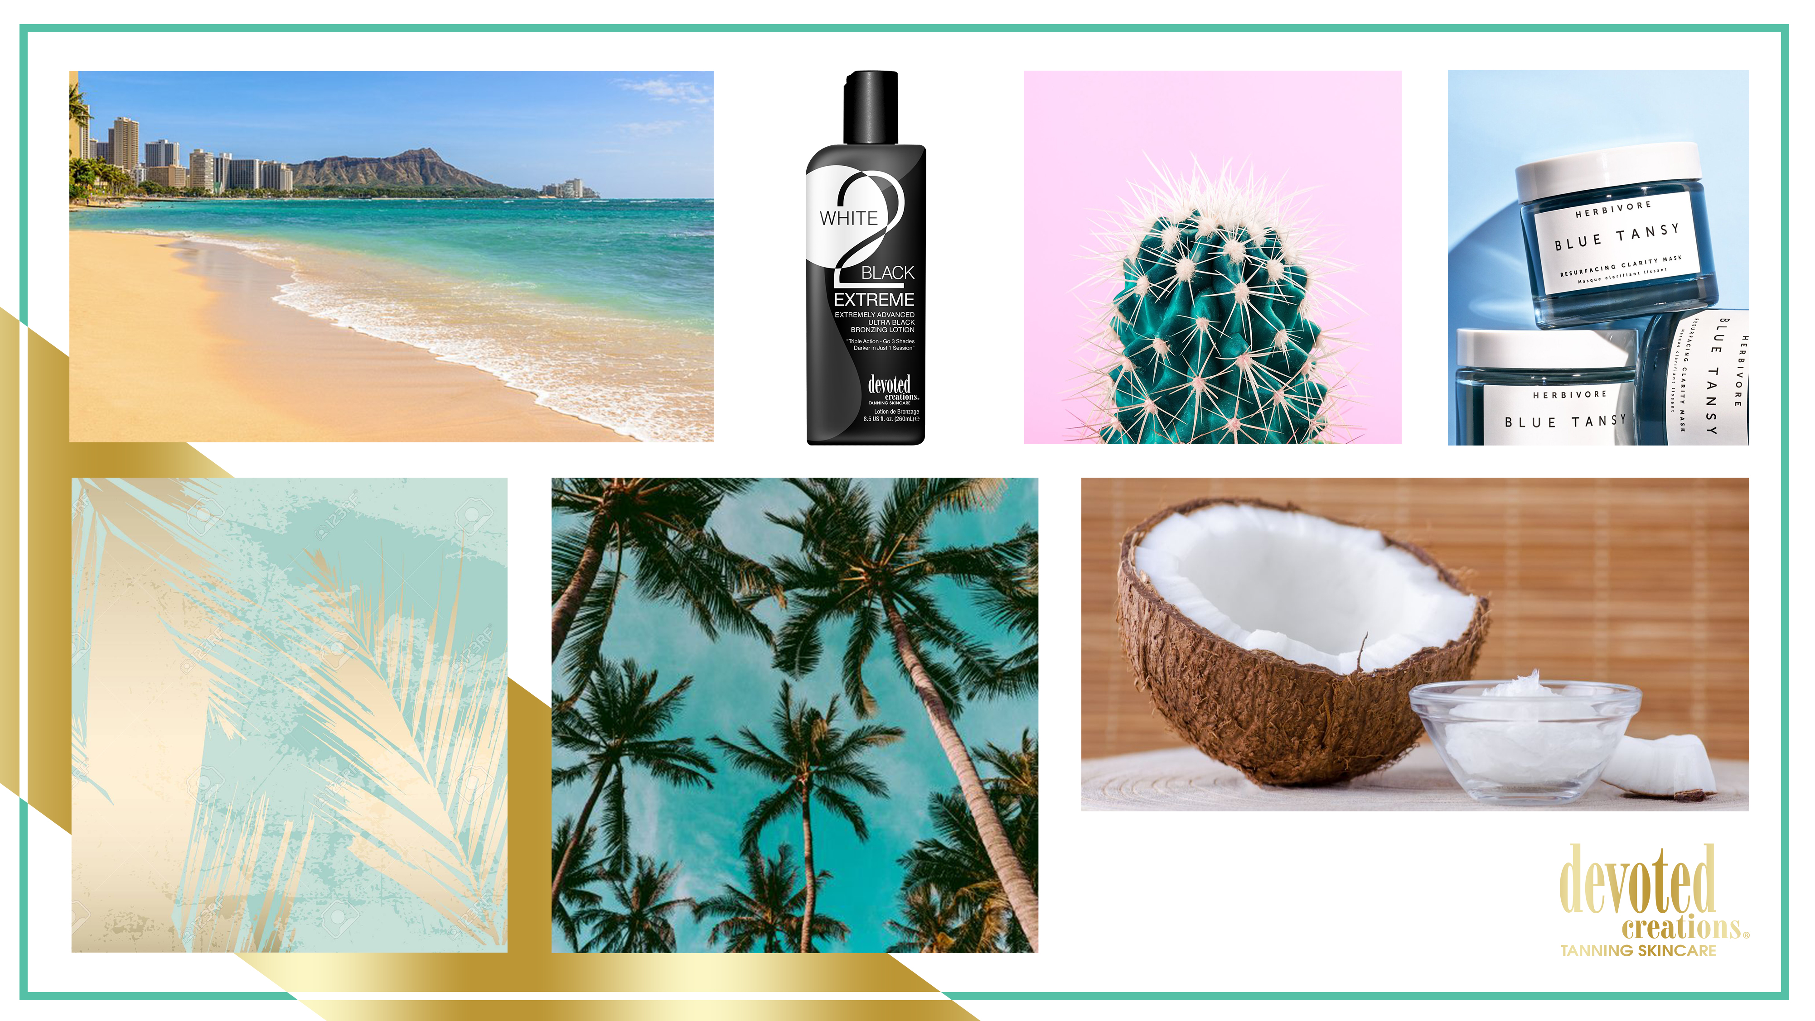

Slide 22
White 2 Black Coconut™ Coconut Infused Dark Bronzing Color Crème Coconut Water + Coconut Oil Allow for Vacation Worthy Results! Go 3 Shades Darker…Today!
Dark Bronzers – a blend of DHA, Natural and Cosmetic Bronzers allow for dark immediate and delayed bronzing results
Cactus Water – High in antioxidants, vitamins and electrolytes to keep skin hydrated while protecting against sun damage, aging and collagen loss
Coconut Oils & Extracts - Deeply softens and nourish the skin for long lasting hydration
Blue Tansy™ – Provides anti-orange agents so the skin develops the most natural, dark bronzed result
ALA Technology™ - Prolongs the life of healthy skin cells for a more youthful appearance to the skin
Fragrance: Waikiki Coconut
Notes:
22

Slide 23
Notes:
23

Slide 24
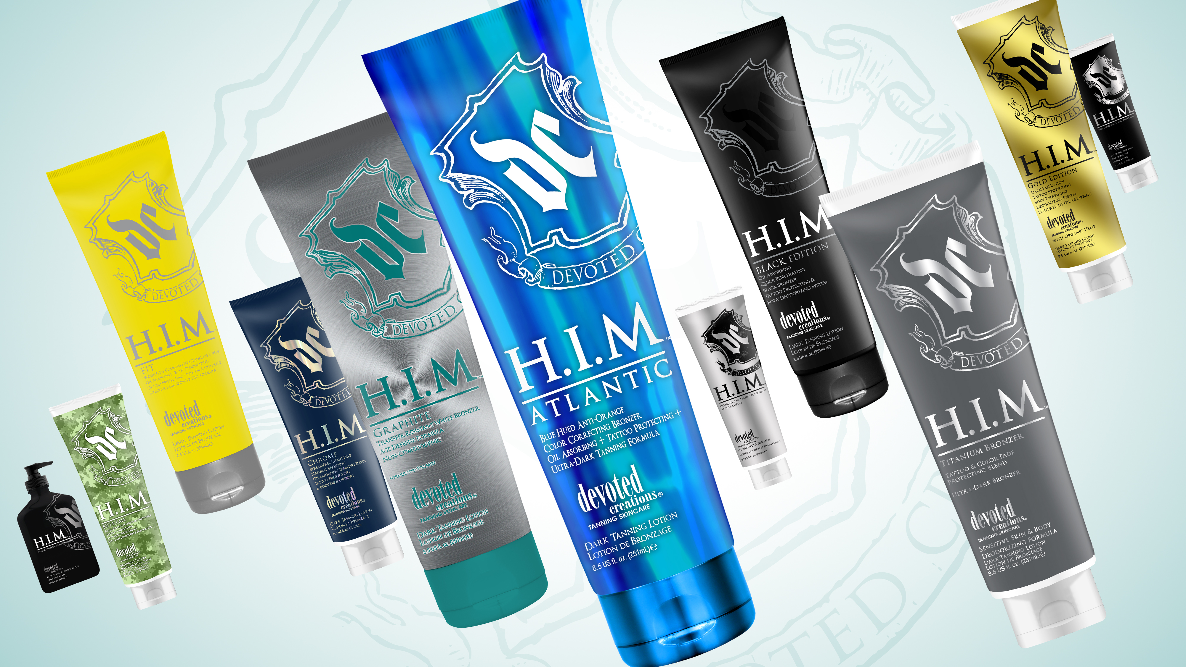
Notes:
24

Slide 26
HIM Atlantic™ Blue Hued Anti-Orange Color Correcting Bronzer
Oil Absorbing + Tattoo Protecting + Ultra Dark Tanning Formula
Blue Hued Bronzing Blend – Allows your skin to develop natural, dark brown just from the beach color
Tiger Grass – Color-Correcting ingredient that reduces redness and helps protect skin from environmental stress and blemishes
Tumeric Root Extract – Known for its antioxidant and anti-reddening properties. Tumeric helps to improve the look for the surface of your skin and create a more. Blemish free, even appearance
Blue Tansy™ – Provides anti-orange agents so the skin develops the most natural, dark bronzed result
Matrixyl Synthe 6™ – Targets and fills in fine lines and wrinkles
Tamanu Oil- A powerful skin regenerator; aiding in wrinkle reducing, blemish-fighting, and moisturize dry skin. Also, helps to hide the appearance of scars and stretch marks
Shea Butter- Helps to soothe dry skin and improves the skin’s elasticity
Avocado Extract – Helps counter act reddening in the skin caused by irritation
Vitamins C & E - Protect the skin from environmental damage, promote a more youthful looking appearance
FreshTek™ – Body deodorizing blend to leave the skin with no after tan odor
SunXTend™ – Extends the life of your tanning results and helps to prevent color fading
Fragrance: Blue Waters
Notes:
26

Slide 27
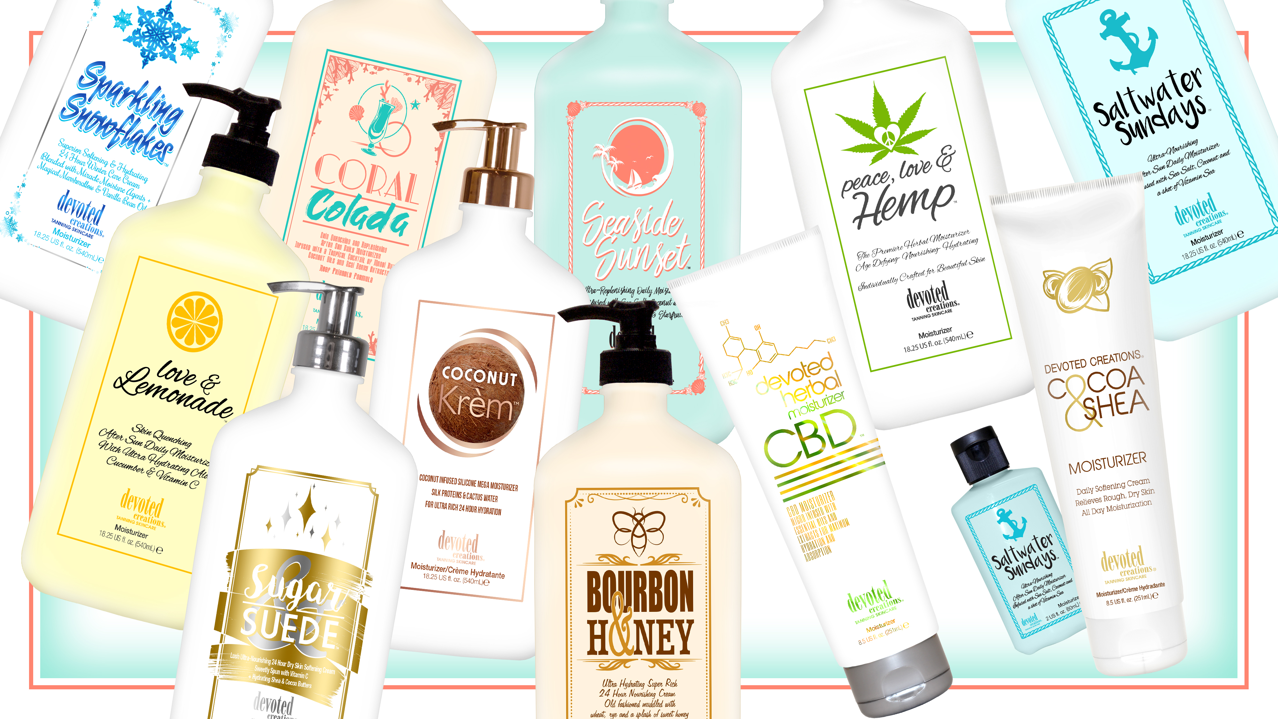
Notes:
27

Slide 28
Sugar & Suede™ Lush Ultra-Nourishing 24 Hour Dry Skin Softening Cream Sweetly Spun with Vitamin C + Hydrating Shea & Cocoa Butters
Daily rich body cream that will keep skin hydrated for up to 24 hours
Cocoa & Shea Butters – Helps to repair dry, damaged and scaly skin
Marshmallow Extract – Antioxidant rich, free radical fighting and complexion boosting natural extract
Vitamin C & Sparkling Plum Antioxidants- Repair skin, fight free radical damage & boost collagen production
White Birch – Anti-aging and skin firming benefits
Cotton & Rice Extract – Soothe and softens the skin without irritation
Vanilla & Sugar Extracts – Natural antibacterial packed with high levels of skin soothing antioxidants that fight breakouts and reduce the signs of aging
Paraben, Nut, Gluten & Sulfate Free Sensitive Skin Formula
Fragrance: Sugar & Suede
Notes:
28

Slide 30
Coconut Krèm™ Coconut Infused Silicone Mega Moisturizer
Silk Proteins & Cactus Water for Ultra Rich 24 Hour Hydration
Silicone Blend – Visibly reduce the look of pores and imperfections while offering non-greasy hydration
Silk Proteins – Acts as a protective shield of hydration, holding in essential moisture and strengthening the skin’s barrier function without weighing it down or clogging pores
Coconut Oil – Deeply softens and nourishes
Matrixyl Synthe 6™ – Targets and fills in fine lines and wrinkles
Coffeeberry - Rich antioxidant that helps to neutralize free radical damage and help to prevent cellular damage in the skin
Cactus Water – High in antioxidants, vitamins and electrolytes to keep skin hydrated
Fragrance: Creamy Coconut
Notes:
30

Slide 31
Notes:
31

Slide 32
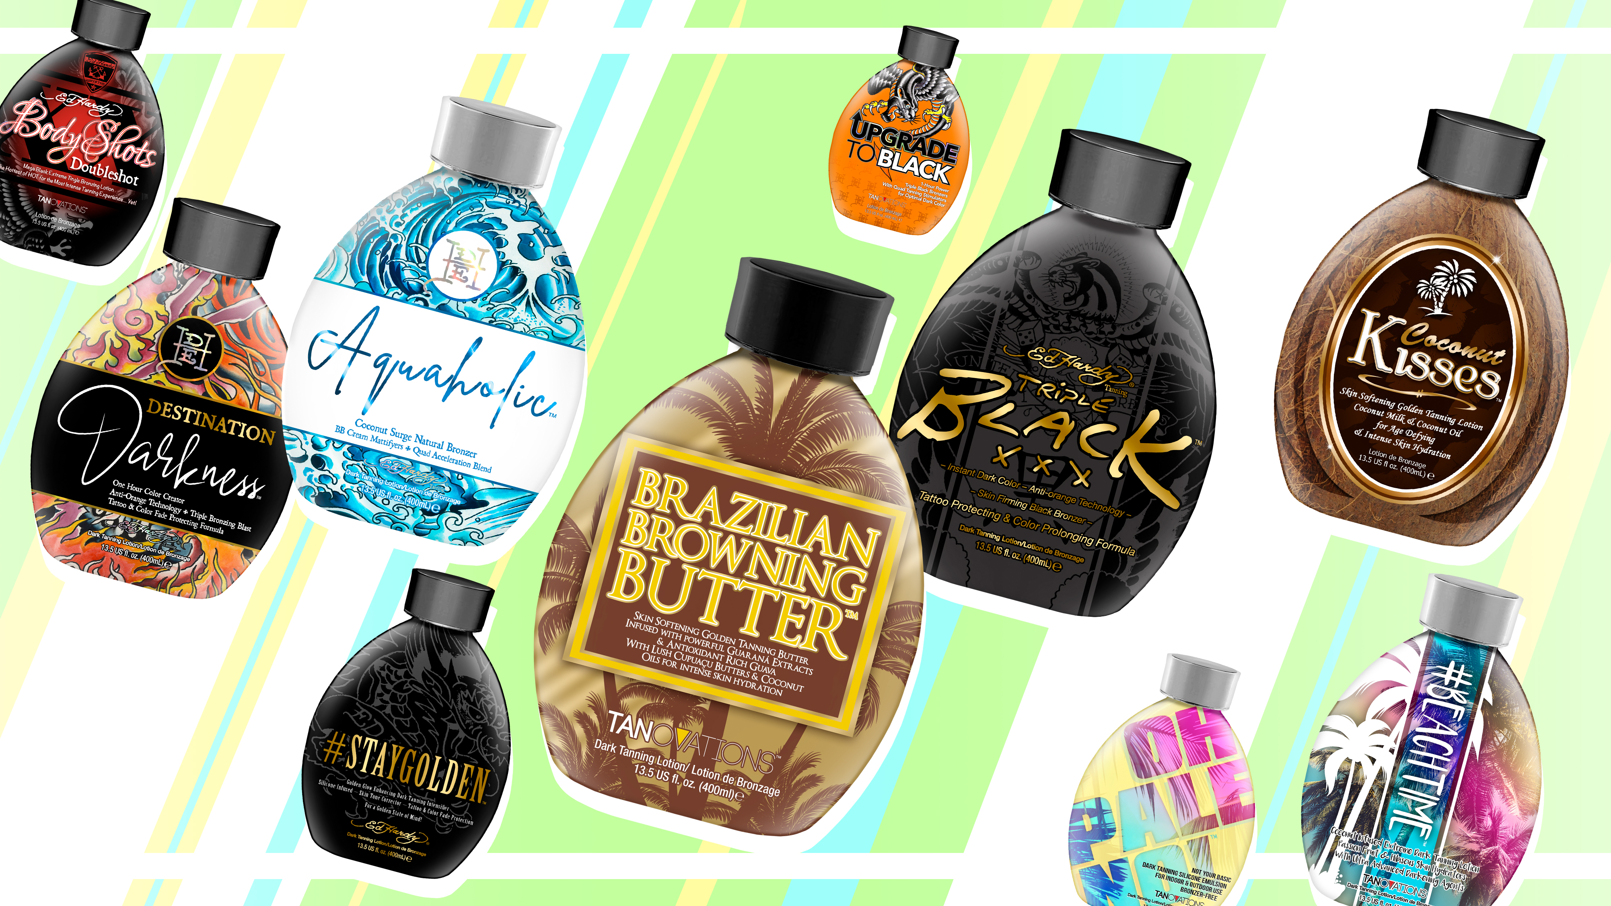
Notes:
32

Slide 33
Triple Black™ Tanovations/Ed Hardy Tanning Instant Dark Color – Anti-Orange Technology – Skin Firming Black Bronzer Tattoo Protecting & Color Prolonging Formula
Dark DHA, Natural & Cosmetic Bronzers provide a deep, dark and long-lasting bronzed result
Superior soft silicone formula allows results to last days longer
Quad Tyrosine allows skin to develop the darkest results possible
Natural oils and extracts will help penetrate dry layers of skin for deeper hydration
Advanced Matrixyl Synthe 6™ – Powerful anti-aging peptide that reduces the appearance of fine lines and wrinkles for long lasting results
Blue Tansy™ – Counteracts orange tones in the skin so you develop long lasting natural results
Acai Berry Extracts – Antioxidant rich to fight free radical damage
After Tan Odor Eliminator - Proprietary blend of deodorizing and skin freshening ingredients
Fragrance: Midnight Rush
Notes:
33

Slide 34
Notes:
34

Slide 35
Brazilian Browning Butter™ Tanovations/Ed Hardy Tanning Skin Softening Golden Tanning Butter $•$ Infused with powerful Guaraná Extracts & Antioxidant Rich Guava With Lush Cupuaça Butters & Coconut Oils for intense skin hydration
Super soft and hydrating dark tanning butter that allows you to develop golden bronze results without self-tanning agents
Cupuaçu Butters – Help to lock in moisture and restore skins elasticity
Quad Tyrosine allows skin to develop the darkest results possible
Guava Extracts – Super fruit antioxidant that helps fight the appearance of wrinkles
Guarana Extracts – Super high in caffeine that helps to tighten and tone the appearance of skin
Coconut Oil – Ultra hydrating for longer lasting, softer results
After Tan Odor Eliminator – Proprietary blend of deodorizing and skin freshening ingredients
Fragrance: Vacation Vibes
Notes:
35

Slide 36
Notes:
36

Slide 37
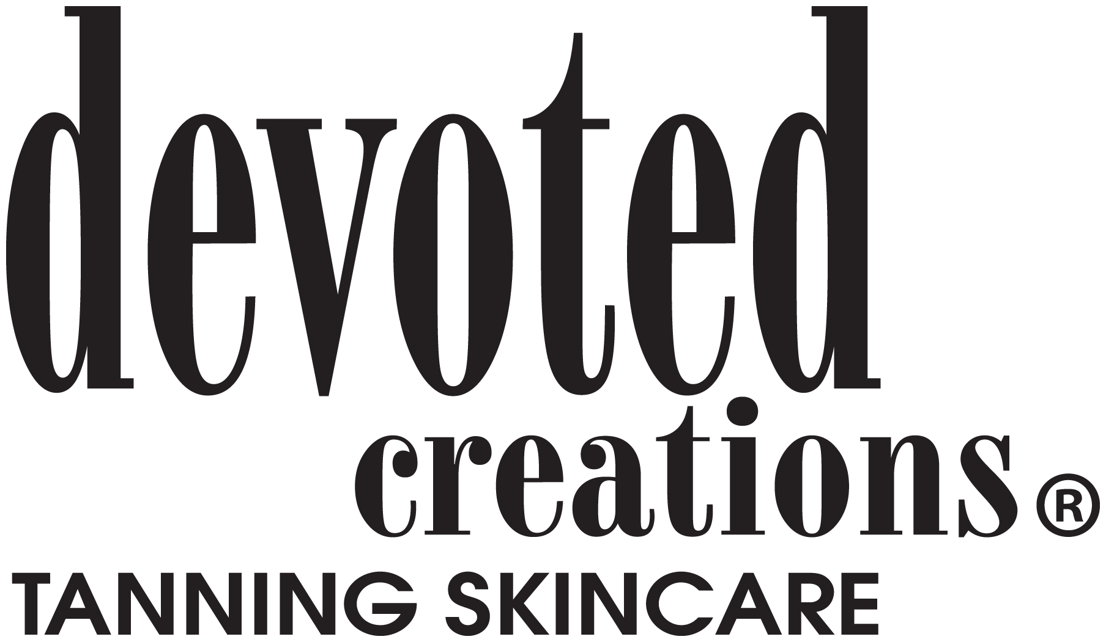
What Brands Are Included?
Notes:
37

Slide 38
Part 1: Qualifications and Percentage Breakdown
Purchase Requirements to qualify for 6% cash back rebate:
At least seventy-five percent (75%) of all salon lotion purchases must be of Devoted Creations’ brand (Devoted Creations™ and Tanovations™).
The salon can only submit purchases made through their selected authorized Devoted Creations’ distributor.
The minimum qualified back rebate within this program must be at least $75.
Notes:
38

Slide 39
Part 2: Co-op Advertising Requirements to Qualify for 2% Cash Back Rebate
The salon must first qualify under part one of the Five Star Diamond Program.
All websites and email blasts related to the promotion and/or marketing of the salon must include the Devoted Creations logo exclusively to any other brands.
Notes:
39

Slide 40
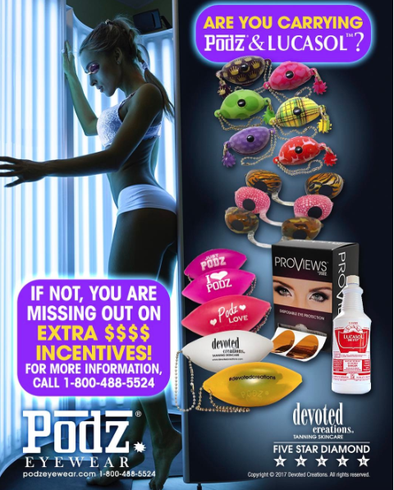
Part 3: Eyewear and Cleanser
**Eyewear and cleanser purchases adds a 2% rebate**
All salon purchases of eyewear and acrylic cleanser are in Lucasol , Podz, and Sunnies brand products.
The salon must first qualify under part one of the Five Star Diamond Salon Program
Notes:
40

Slide 41
How much is bottle Spiff?
Color Rush Collection: $0.75 Per Bottle Rebate
DC Classic Collection: $0.50 Per Bottle Rebate
Pauly D Collection: $0.25 Per Bottle Rebate
Soho Collection: $0.20 Per Bottle Rebate
**WE ARE THE ONLY MANUFACTURER THAT STILL OFFERS A BOTTLE SPIFF**
Notes:
41

Slide 42
What’s Included In My Kit?
Notes:
42

Slide 43
TYPES OF TRAINING WE OFFER:
On Demand Training
UNLIMITED 24/7, 365 DAYS A YEAR
Web Training
BASED ON REQUEST AND TRAINER AVAILABILITY
In-Salon Training/ ITC:
Instore or interactive web center based on the salons needs
No minimum number of attendees!!
Notes:
43

Slide 44
Lisa Saavedra(Parsons)
Director of Brand Development
Lisa@DevotedCreations.com
Notes:
44

